Slide 1
Design Guide
Blackfin System On Module (SOM)

Slide 2
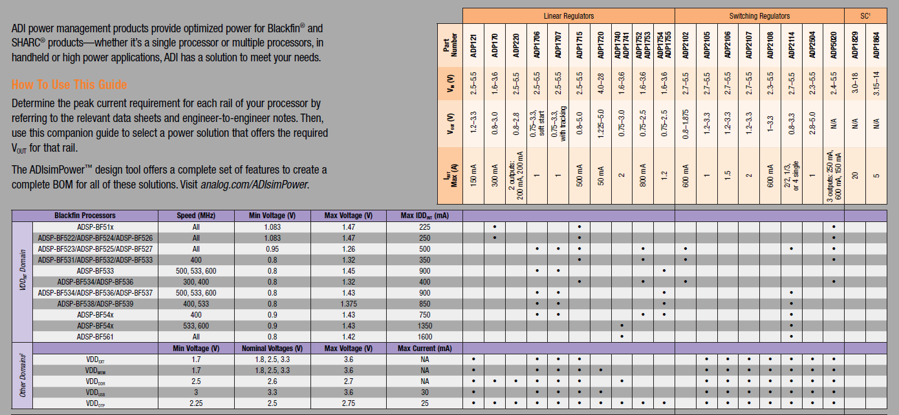
Component Selection
POWER

Slide 3

Component Selection
Excellent Reference

Slide 4

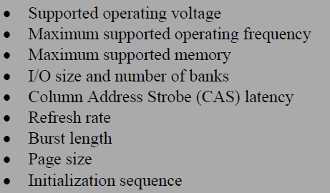
Component Selection
SDRAM

Slide 5
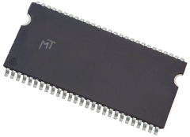

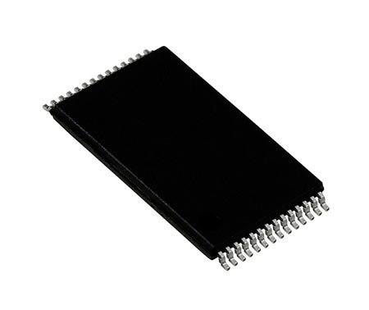
TIP: Boot Sequence
Boot sequence:
1. Start from internal ROM
2.Communicate with SDRAM
RAM
3. Execute boot loader and prepare SDRAM (SDRCON)
ADSP
2.Fetch external Boot loader (uBoot)
Flash

Slide 6
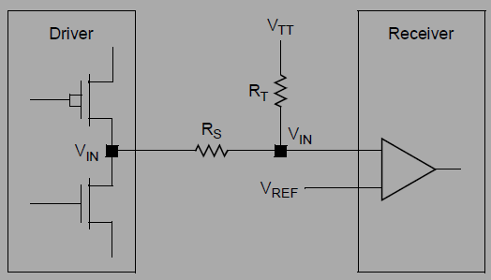
DDR Memory Interfaces
Design challenges
  Routing requirements
  Power supply and decoupling, which includes the DDR devices and controller, the termination rail generation (VTT), and reference generation (VREF).
  Proper termination for a given memory topology.
Joint Electron Device Engineering Council (JEDEC) created and adopted a low voltage signaling standard: series stub termination logic (SSTL).
  The 2.5 V version, named SSTL-2, is prominent with DDR1

Slide 7
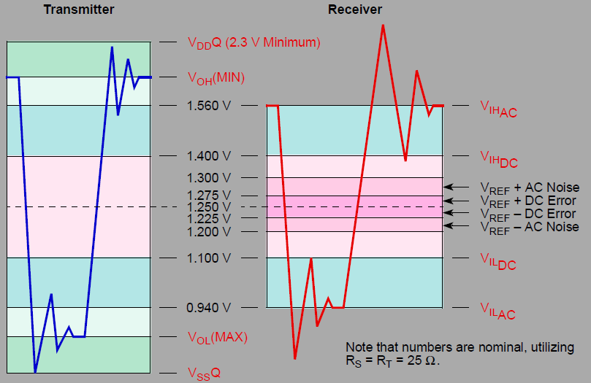
DDR Memory Interface
Values for RS and RT are system-dependent and should be derived by board simulation.
SSTL buses are less susceptible to overshoot, undershoot, and ringing effects.
150 mV voltage ripple bond.

Slide 8
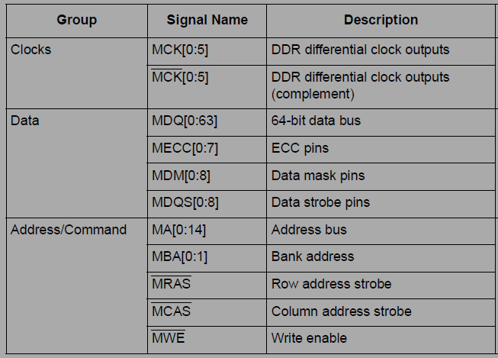
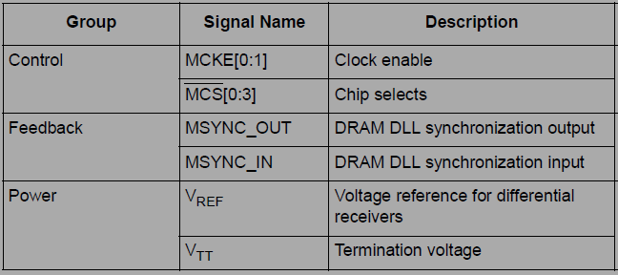
Select Termination Resistors
Termination Dissipation

Slide 9
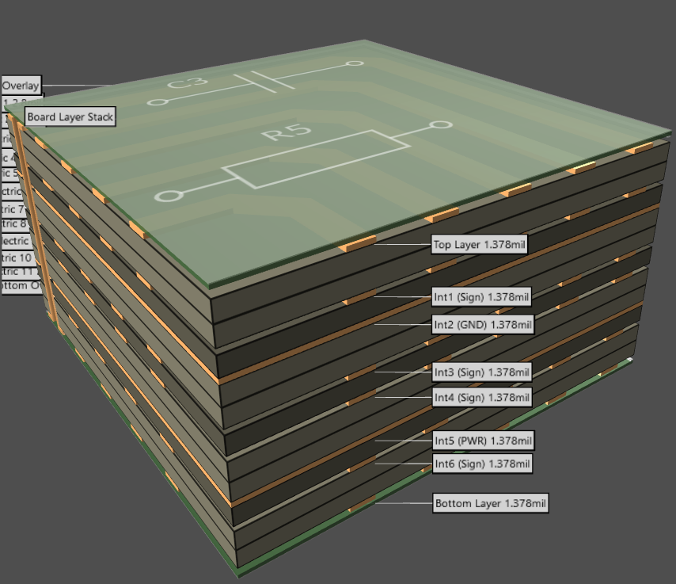
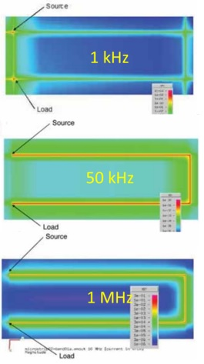
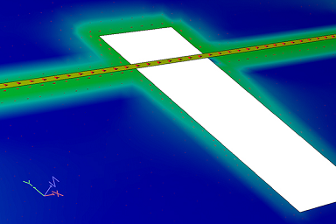
DDR Signal Tracing
DDR signals on layers that are ground-referenced.
A Simple Demonstration of Where Return Current Flows | 2020-06-15 | Signal Integrity Journal

Slide 10
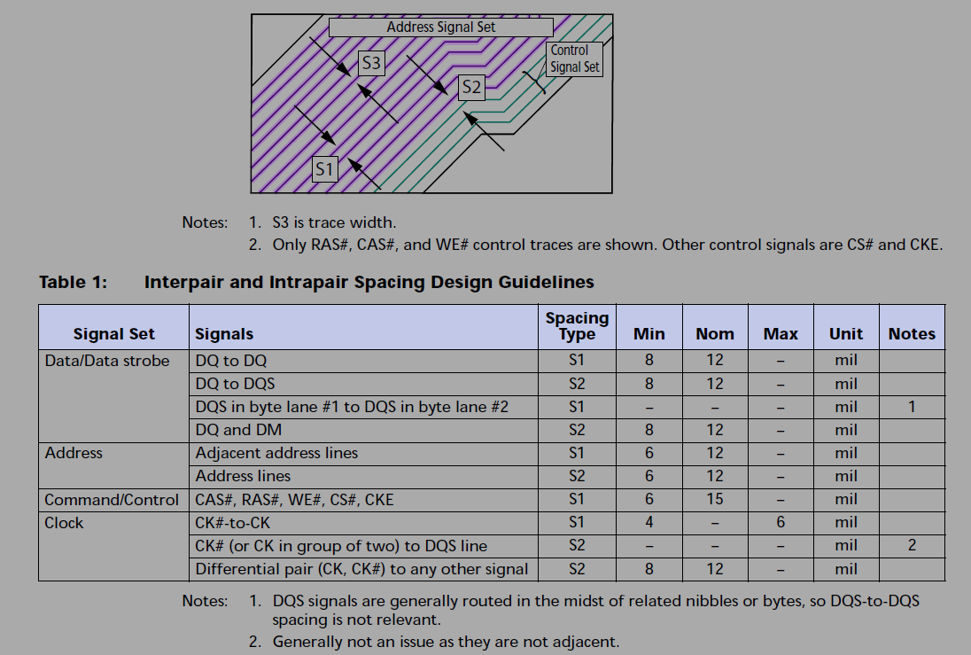
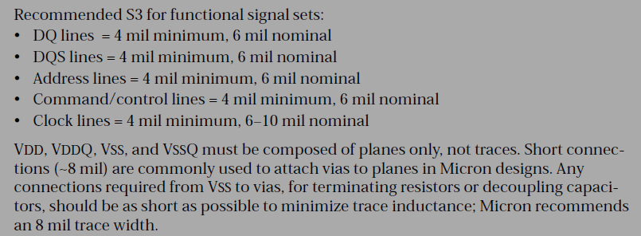
DDR Signal Tracing
If trade-offs must be made:
  data and clock signal groups to be routed over solid ground planes
  Other DDR signal groups to be routed over solid power plans.

Slide 11
Why Vtt is Missing?
VTT is recommended for maximum voltage accuracy and current delivery
Requires a regulator with ±3 percent tolerance
Some system designs can operate without requiring VTT
  Two or fewer DDR components in the system
  Moderate current draw
  Trace length <2in (5cm)
  SI and drive strengths within data sheet limits (determined through simulation)

Slide 12
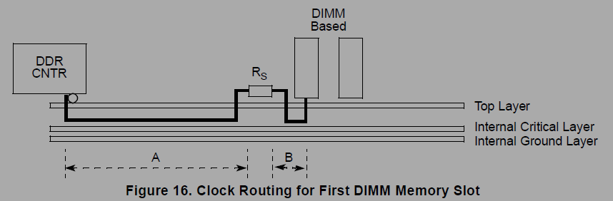
DDR Signal Tracing
Clock Group Topology
All signal groups except the clocks and feedback are length-matched per slot to their respective DIMM
The clocks themselves are matched to within a certain length

Slide 13

EXTRA Point

Slide 14
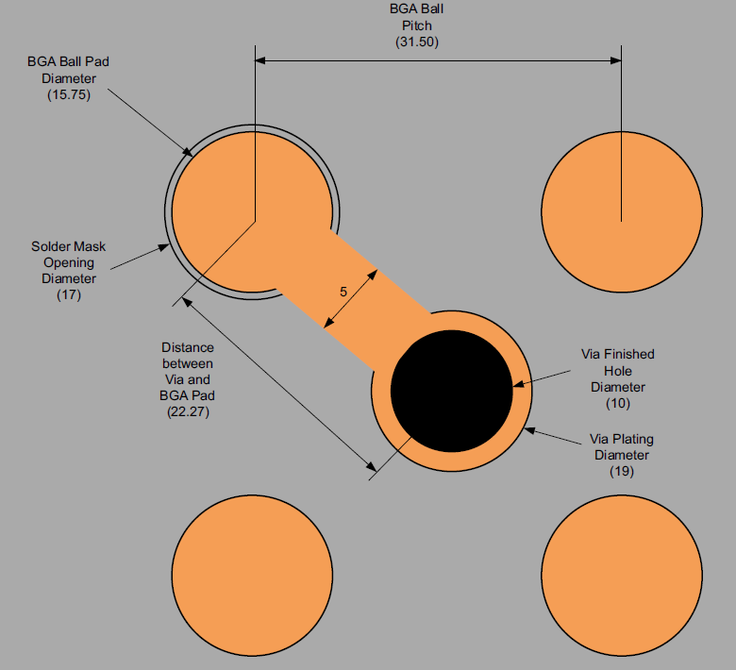
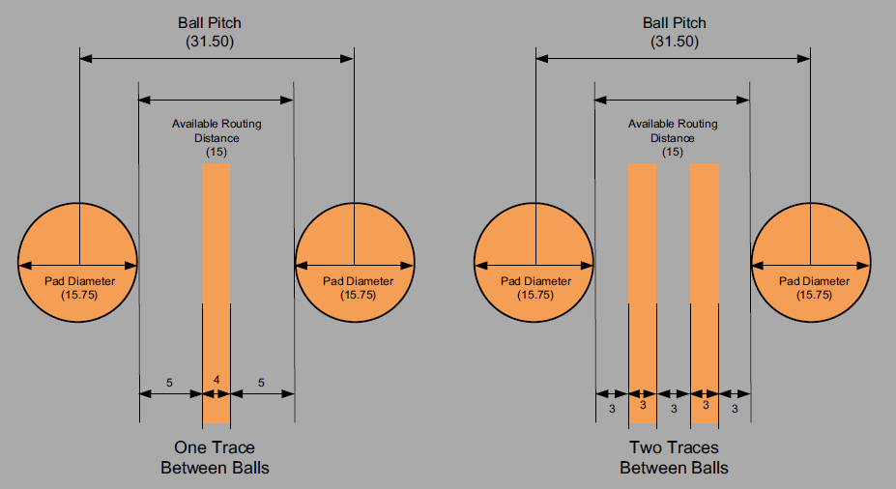
BGA Fanout

Slide 15
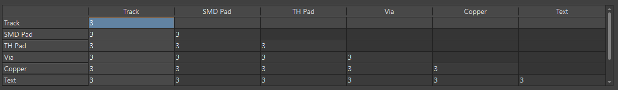
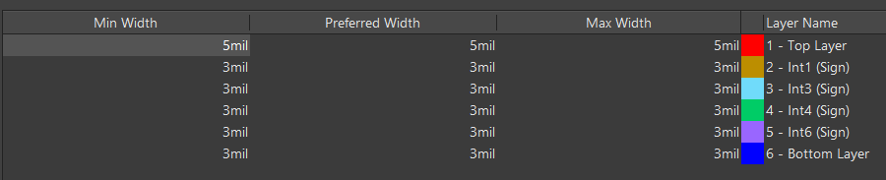
BGA Fanout Rules

